Slide 1
The Impact of Malnutrition
Why Food IS the Medicine that comes First

Slide 2
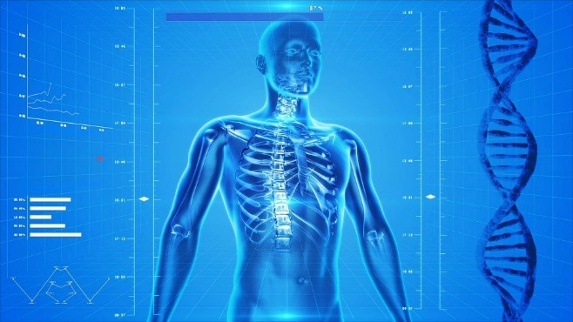
The Impact of Malnutrition
The Body
The Brain
Relationships
Images copyright @ www.pixabay.com
Images copyright @ www.pixabay.com
Notes:
One o

Slide 3
Notes:
The severity of medical problems associated with eating disorders is significant and should not be underestimated however the patient appears outwardly. Mortality in anorexia nervosa is the highest of any psychiatric illness.
As you can see from this slide the medical complications of both Bulimia Nervosa and Anorexia Nervosa are multi-system and can have both acute life threatening and long term sequelae.
It is again important to note that individuals at normal or above normal body weight that lose an excessive amount of weight may show similar changes in medical status as the individual who starts at normal or low body weight and loses even more.
A story that has been related to me by patients suffering with BN is a practitioner that looks at them and says “you don’t look like you have an ED” while potentially this average or overweight individual may have a serious electrolyte issue that is caused by repetitve bingeing and purging activity.
The primary pathophysiologic response to extensive weight loss is one of metabolism reduction as a physiologic adaptation as shown in the classic Minnesota experiment of semistarvation and refeeding.

Slide 4
Image copyright @ www.pixabay.com

Slide 5
What about the co-morbidities?
A semi-starved brain is a wonderful mimic of psychiatric illness (can LOOK like, Depression, Anxiety, Psychosis…)
Family history and pre-morbid psychiatric history are helpful in making additional diagnoses.
Medications can sometimes be useful to manage symptoms of distress in recovery.
There are no medications that specifically “treat” Anorexia Nervosa, but sometimes medications can be a useful part of the treatment plan.

Slide 6
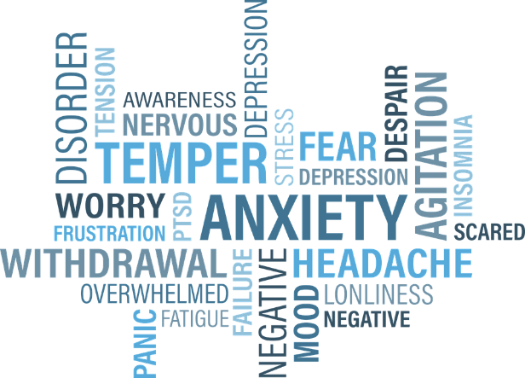
A Starving Brain
Mood Instability
Depression
Anxiety
Anger
Reactivity
Hypochondriasis
Preoccupation with food
Social withdrawal
Images copyright @ www.pixabay.com
Notes:
Elliott and Pinzon, CPS June 2006
6
Monique:
Here I’ve transitioned to talk about the process of care in refeeding. I’m trying to highlight the difficulties inherent in helping a precontemplative hospitalized patient with a starved brain. I thought there could be a lot of medical points to be made here-

Slide 7
Semi-starvation and engagement
Starvation…
Individuals can become less capable of interpreting emotion
Individuals can become less capable of mentalizing
Individuals expressed affect can be reduced
Individuals can become less socially capable
Individuals become increasingly isolated and socially disconnected….
Images copyright @ www.pixabay.com

Slide 8
Restriction/
malnutrition
Brain Changes/
Established coping style
Worsening rigidity
Worsening obsessionality
Etc….
The “voice” of the Eating Disorder steps in here, and worsens the problem
“You are too big!”
“They are trying to make you fat..”
Interpersonal deficits
Social Isolation
When the Interpersonal deficits are not understood, carers often become exhausted, exasperated, punitive.
As they distance themselves the ED tightens it’s grip further….
Entrenched Eating Disorder
Chronicity- Neural pathways further reinforced…

